Slide 1
Lecture 3
Data Structures and Algorithms

Slide 2
Problem Solving: Main Steps
Problem definition
Identify Relevant Data Structures
Design and Plan
Algorithm design / Algorithm specification
Algorithm analysis
Implementation
Testing
Maintenance

Slide 3
1. Problem Definition
Clearly define the problem and understand the input and output requirements.
Identify any constraints or special conditions.
What is the task to be accomplished?
  Calculate the average of the grades for a given student
  Understand the talks given out by politicians and translate them in Chinese
What are the time / space / speed / performance requirements ?

Slide 4
2. Identify Relevant Data Structures:
Determine which data structures are most suitable for solving the problem.
Common data structures include arrays, linked lists, stacks, queues, trees, and graphs.

Slide 5
3. Design and Plan
Devise a plan or algorithm for solving the problem using the chosen data structures.
Consider time and space complexity to ensure efficiency.

Slide 6
4. Algorithm Design / Specifications
Algorithm: Finite set of instructions that, if followed, accomplishes a particular task.
Describe: in natural language / pseudo-code / diagrams / etc.
Criteria to follow:
  Input: Zero or more quantities (externally produced)
  Output: One or more quantities
  Definiteness: Clarity, precision of each instruction
  Finiteness: The algorithm has to stop after a finite (may be very large) number of steps
  Effectiveness: Each instruction has to be basic enough and feasible
    Understand speech
    Translate to Chinese

Slide 7
Computer Algorithms
An algorithm is a procedure (a finite set of well-defined instructions) for accomplishing some tasks which,
given an initial state
terminate in a defined end-state
The computational complexity and efficient implementation of the algorithm are important in computing, and this depends on suitable data structures.

Slide 8
5. Algorithm Analysis
Space complexity
  How much space is required
Time complexity
  How much time does it take to run the algorithm
Often, we deal with estimates!

Slide 9
Space Complexity
Definition: Space complexity is a measure of the amount of memory space an algorithm needs with respect to the size of the input to the algorithm.
Notation: Similar to time complexity, space complexity is also expressed using Big O notation (e.g., O(n), O(log n), O(n^2)), where "n" represents the size of the input.
Purpose: Space complexity helps in understanding how the memory requirements of an algorithm grow as the input size increases. It provides an upper bound on the amount of memory space used in the worst-case scenario.

Slide 10
Space Complexity (cont’d)
Fixed part: The size required to store certain data/variables, that is independent of the size of the problem:
  - e.g. Array
  - same size for classifying 2GB or 1MB of texts
Variable part: Space needed by variables, whose size is dependent on the size of the problem:
  - e.g. actual text
  - load 2GB of text VS. load 1MB of text

Slide 11
Time Complexity
Definition: Time complexity is a measure of the amount of time an algorithm takes with respect to the size of the input to the algorithm.
Notation: It is often expressed using Big O notation (e.g., O(n), O(log n), O(n^2)), where "n" represents the size of the input.
Purpose: Time complexity helps in understanding how the execution time of an algorithm grows as the input size increases. It provides an upper bound on the running time in the worst-case scenario.

Slide 12
Time Complexity
Often more important than space complexity
  space available (for computer programs!) tends to be larger and larger
  time is still a problem for all of us
3-4GHz processors on the market
  still …
  researchers estimate that the computation of various transformations for 1 single DNA chain for one single protein on 1 TerraHZ computer would take about 1 year to run to completion
Algorithms running time is an important issue

Slide 13
Best case Time Complexity
  The measurement of minimum time that is required by an algorithm to complete its execution is known as Best Case Time Complexity.
  Time complexity of particular algorithm can be calculated by providing different input values to the algorithm.
  Consider an example of sorting N elements. If we supply input values that is already sorted, an algorithm required less time to sort them.
  This is known as Best case time complexity. However best case time complexity does not guarantee that the algorithm will always execute within this time for different input values.

Slide 14
Average case Time Complexity
  The measurement of average time that is required by an algorithm to complete its execution is known as Average Case Time Complexity.
  Time complexity of particular algorithm can be calculated by providing different input values to the algorithm.
  Consider an example of sorting N elements. Average time complexity can be calculated by measuring the time required to complete the execution of an algorithm for different input values and then calculate the average time required to sort N elements

Slide 15
Worst case Time Complexity
  The measurement of maximum time that is required by an algorithm to complete its execution is known as Worst Case Time Complexity.
  Time complexity of particular algorithm can be calculated by providing different input values to the algorithm.
  Consider an example of sorting N elements. If we supply input values that is in reverse order, an algorithm required maximum time to sort them. This is known as worst case time complexity.
  Thus, worst case time complexity always guarantees that the algorithm will always execute within this time for different input values.

Slide 16
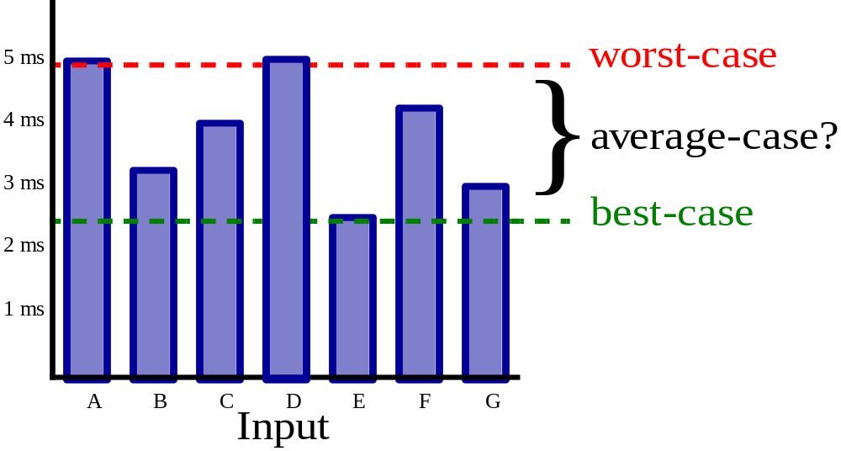
Running time
Suppose the program includes an if-then statement that may execute or not: → variable running time
Typically algorithms are measured by their worst case

Slide 17
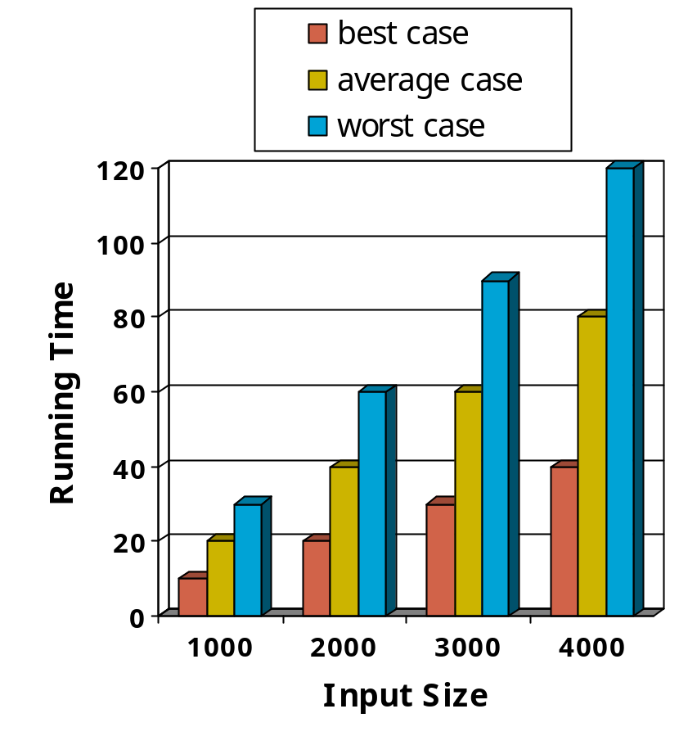
Running Time
The running time of an algorithm varies with the inputs, and typically grows with the size of the inputs.
To evaluate an algorithm or to compare two algorithms, we focus on their relative rates of growth wrt the increase of the input size.
The average running time is difficult to determine.
We focus on the worst case running time
  Easier to analyze
  Crucial to applications such as finance, robotics, and games

Slide 18
Pseudocode
Pseudo code is an outline of a program, written in a form that can easily be converted into real programming statements
High-level description of an algorithm.
More structured than plain English.
Less detailed than a program.
Preferred notation for describing algorithms.
Hides program design issues.
Pseudo code neither is compiled nor executed

Slide 19
Examples
Display the result of a student as “Pass” if the percentage is greater than or equal to 60% and “Fail” otherwise
Example: find the max element of an array
Algorithm arrayMax(A, n)
Input array A of n integers
Output maximum element of A
currentMax ← A[0]
for i ← 1 to n − 1 do
if A[i] > currentMax then
currentMax ← A[i]
return currentMax
IF Percentage >=60%
Print “Pass”
Else
Print “Fail”

Slide 20
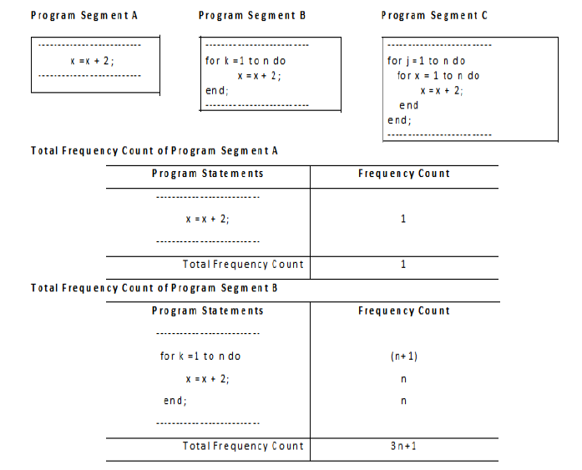
Analyzing Algorithms
The most common computing times are
For Example

Slide 21
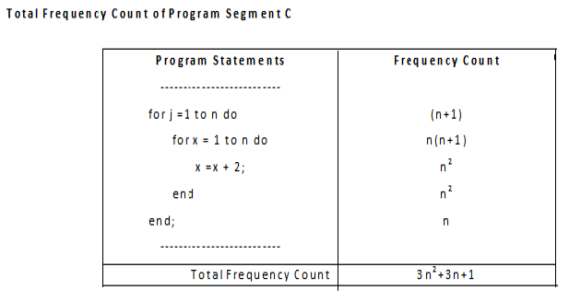
The total frequency counts of the program segments A, B and C given by 1, (3n+1) and (3n²+3n+1) respectively are expressed as O(1), O(n) and O(n²).

Slide 22
6. Implementation
  Translate your pseudocode or algorithm into actual code.
  Pay attention to details and follow best practices for coding.
  Decide on the programming language to use
    C, C++, Lisp, Java, Perl, Prolog, assembly, etc. , etc.
  Write clean, well documented code

Slide 23
7. Test and Debug:
Test your code with different inputs, including edge cases.
Debug any errors or unexpected behavior.

Slide 24
8. Maintenance
Integrate feedback from users, fix bugs, ensure compatibility across different versions

